Slide 1

Foundations of Entrepreneurship
Manoj Kumar Mondal
Rejendra Mishra School of Engineering Entrepreneurship, IIT Kharagpur
Topic: Cost, Volume, Profit Analysis – Break-Even Point Analysis
Lecture Note # 23 05/10.03.2021

Slide 2
Relation between cost and volume of sales with profit
Break-Even-Point (BEP) analysis.
Advantages and limitations of BEP.
Margin of safety.
Operating and financial leverage
Cost-indifference point

Slide 3
Managerial Accounting
Managerial accounting involves the presentation of financial information for internal purposes to be used by management in making key business decisions.

Slide 4
Managerial Accounting
Budgeting, Trend Analysis, and Forecasting
Accounts Receivable (AR) Management
Constraint Analysis
Inventory Turnover Analysis
Financial Leverage Metrics
Cash Flow Analysis
Product Costing and Valuation

Slide 5
Managerial Economics
Managerial economics deals with the decision making process by mangers and entrepreneurs in response to changing macro and micro economic conditions.
Managerial Economics provides the process of applying economic theories & methods and the tools of analysis of decision science in management decision process for appropriate actions under changing economic conditions.

Slide 6
Managerial Economics – Seven Key Components
(i) Demand Analysis & Forecasting (helps to plan production, price, promotion and logistics)
(ii) Cost and Production Analysis – cost drivers, cost optimization by combining factor inputs,
(iii) Inventory Management – inventory cost money and disruption of supply affect production. Optimization is the key.
(iv) Advertising – Profit is related to sales, which can be increased by advertising. How much to spend and in what media is critical.
(v) Pricing Decision, Policies and Practices – profit is dependent on price, which has causal relation with sales.
(vi) Profit Management (how much profit to target and how to achieve that at what sales)
(vii) Capital Management (selection of alternative business models, capital investment decisions, hiring decisions, aiming to maximize return on capital)

Slide 7
Demand
Supply
Price
Quantity

Slide 8
Demand
When demand goes up and supply remains same, price tends to go up. The equilibrium moves up in price and in quantity.
Supply
Price
Shift in demand
When demand goes down and supply remains same, price tends to go down. The equilibrium moves down in price and in quantity.
Quantity

Slide 9
Supply - 2
Demand
When supply goes down and demand remains the same, price tends to go up. The equilibrium moves up in price and down in quantity.
Supply - 1
Price
Shift in supply
When supply goes up and demand remains same, price tends to go down. The equilibrium moves down in price and up in quantity.
Quantity

Slide 10
When supply goes down and demand goes up, price tends to go up. The equilibrium moves up in price and though quantity may remain inelastic.
Supply - 2
Demand
Supply - 1
Price
Shift in supply
When supply and demand both go up, price tends to remain inelastic. The equilibrium moves up in quantity.
Quantity

Slide 11
Break Even Point
Selecting a business model out of multiple choices or analyzing suitability of a particular business model based on market size.
How much minimum sales to be made to reach to profitable operation.
To estimate profitability at different scale of operation
Scenario analysis or sensitivity analysis with respect to change in selling price or cost structure – how it impact bottom-line (marginal cost & marginal revenue).
Comparing two different technologies based on their cost structure or substituting one over another.
Assessing the comfort under market distress
Estimate how low value you can quote for a project

Slide 12
You want to maximize profit
Profit
Cost
Volume

Slide 13
How much to spend on advertisement and what is the gain?​
Your objective is to increase profit.
You advertise, but you incur cost in the process.​
Objective is Profit
Profit is a percentage of sales (revenue).​
You try to sell more, but how do you achieve that?
Or reduce the cost!! How to achieve that? Use automation! But the capital cost may be huge!​
To increase profit, needs higher sales.
Alternately increase price, which may be unsustainable.​

Slide 14
Sales
Sales
Sales
Sales
Cost
Cost
Cost
Cost
Profit
Profit
Profit

Slide 15
Profit = Sales – Total Cost Sales = Unit Price X Number of Products Sold.
Profit
Sales
Volume
Cost
Price
Fixed Cost
Total Cost
Variable Cost

Slide 16
Fixed Cost
Variable Cost
Sales
Profit

Slide 17
Relation Between Cost, Volume and Profit
Profit = Sales minus all the expenses
Price of a product is fixed.
But cost of single unit of product varies as production increases.
And it may be difficult, if not impossible, to sell beyond certain quantity.
Therefore, you need to find which business can potentially give profit at lower sales.
But what if another business is profitable only at higher sales, but the profitability is much higher.

Slide 18
Cost and Cost Drivers
Cost drivers are the factors or inputs which cause change in the cost of an activity. The cost of an activity may be driven by more than one cost drivers.
In the context of a restaurant, suppose the selling price of a particular item is to be determined based on its cost of production:
For every plate of this item, a list of ingredients will add to the total cost. Say for ‘mixed veg’ cost of vegetables, spices, cooking energy etc. directly add to the cost of the item. Cost of each such item is cost driver.
Say, you want to manufacture a plastic bucket: you need plastic granules, electricity to heat and melt the granules, machine hours to mould, labor, rent of the premises, depreciation of the machine etc. If requirement or cost of any of these items increases, the cost of the bucket will rise and vice versa.
When an item or service is procured and used up immediately, the cost is easy to allocate. But when it is used for a long period, the cost is difficult to allocate.

Slide 19
Cost Classification
Two ways of classifying costs
Product specific: Costing
Company specific: BEP
Direct cost – directly traceable on each product such as raw-materials, direct labor costs.
Indirect cost – difficult to estimate exact cost on each product.
This method of classification is used in the process of costing of an activity for manufacturing a product or rendering a service.
Fixed cost – Cost that is not related to activity level - a company has to bear it even if there is no activity.
Variable cost – proportional to level of operation.
This method of classification is used in estimating break-even point.

Slide 20
Cost Drivers
Cost of fabric
Wages to tailor
Cost of buttons
Cost drivers for a shirt
Rent-F
Depreciation - F
A factor, change of which, causes a change in the cost of an activity.
An activity can have more than one cost drivers attached to it. For example, change in cost of fabric, wages to tailor, cost of button, machine hour, electricity, thread, interest rate and rent of space are cost drivers for a shirt.
Salary-F
Interest on loans-V
Maintenance - F&V
Insurance – F&V
Utilities – F&V
Direct & Variable Costs
Indirect Costs

Slide 21
Fixed and Variable Costs
Fixed costs are defined as expenses that do not change as a function of the activity of a business, within the relevant period. For example, a manufacturer must pay rent of factory premises, utility bills, depreciation, salary to administrative staff, interest on term loan, etc. irrespective of the level of activities and sales.
Interestingly, fixed cost on per unit basis decreases as production increases and
Variable cost remains constant on per unit basis
Notes:
While in practice, all costs vary over time and no cost is a purely fixed cost, the concept of fixed costs is necessary in short term cost accounting. Organizations with high fixed costs are significantly different from those with high variable costs. The entire fixed cost is divided by the amount produced during a period and therefore the unit fixed cost reduces as production increases.
Variable cost is one that changes in direct proportion to the change in its cost driver activity level. A cost that varies in step with the output or the sales revenue of a company is called variable cost. Cost of raw material, energy usage, labor, distribution costs, etc. are examples of variable costs.
As the production volume changes, the material cost changes, but the machine cost per hour does not change.
Material Cost: Variable cost; Machine cost: Fixed cost

Slide 22

Many items of cost
One or very few revenue stream(s)
Sales
Costs Costs Costs Costs Costs Costs Costs Costs Costs
Costs Costs Costs Costs Costs Costs Costs Costs Costs

Slide 23
The challenge is that some costs do not change with volume. Some costs are directly proportional to volume produced. One cannot apply unitary method to understand profitability under different contexts.
#
#
#
Cost amount
Sales amount
Volume

Slide 24
#
Group all the costs into
Those which do not change with volume – add them up for the relevant period.
Those which change in proportion to volume – estimate their contribution to unit product.
♦
♦
Cost amount
Sales amount
Volume

Slide 25
Why separating cost into fixed & variable?
To be able to rationally and logically allocate costs.
It is easy to allocate some direct costs to a particular product.
But difficult to allocate many of the costs.
Wrong allocation would lead to wrong costing and thus wrong pricing.
Example

Slide 26
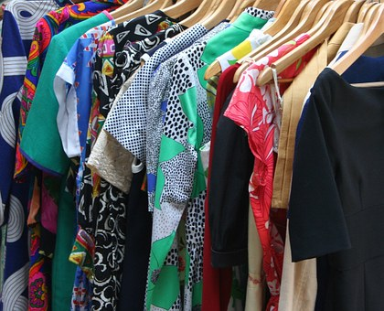
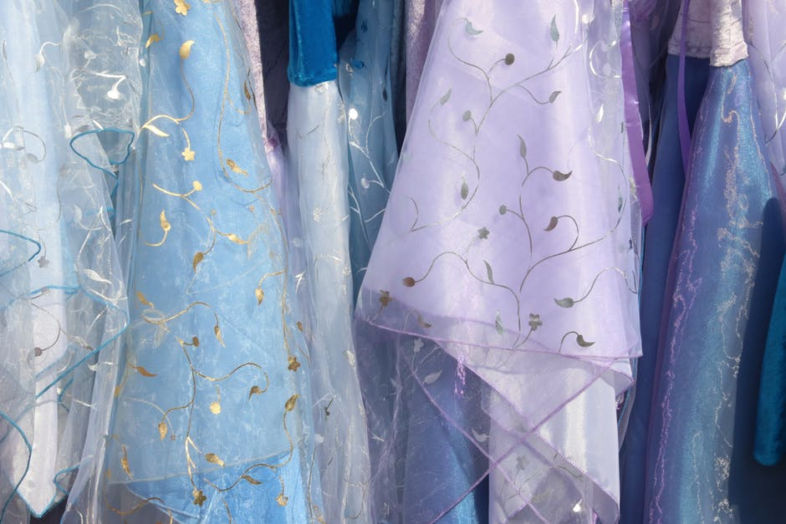

Suppose you intend to set up a readymade garment business. Let us see the cost structure

Slide 27
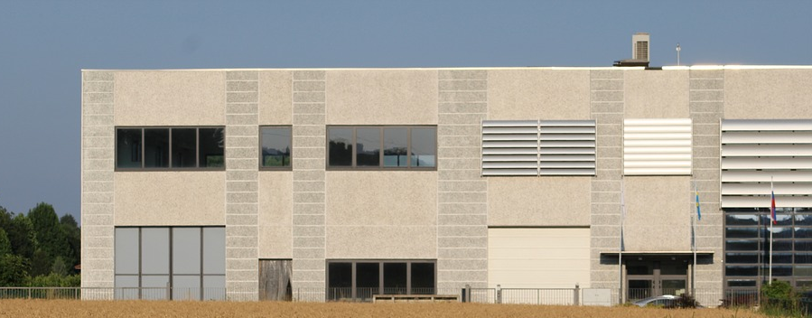
Fixed Cost. Indirect Cost.
Rent

Slide 28

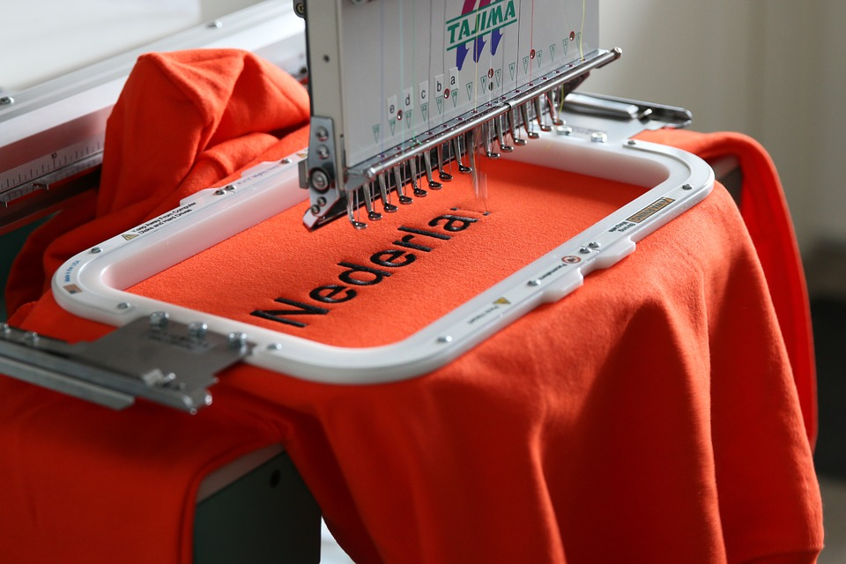
Machinery
Machinery: Money spent on machinery has to be recovered in the form of annual depreciation.

Slide 29
Fixed Costs [ for a full year]
Rent: ₹ 120,000
Depreciation: ₹ 15,000
Administrative overhead:₹ 5,00,000
Total fixed cost for a year: ₹ 6,35,000

Slide 30
Fixed costs are mostly those which are paid periodically such as rent, depreciation, salary, etc.
However, costs such as electricity bills, telephone bill, and other utilities, though paid periodically, are not fixed in nature.

Slide 31



Variable Cost Direct Cost
Materials

Slide 32











Materials & Labor cost
₹400
₹100
₹10
₹20
Total variable cost: ₹530 per unit. For n unit: nX₹530

Slide 33

Salary paid to regular employees – Fixed Cost. Wages paid to contractual workers – Variable Cost

Slide 34

Variable Cost: Electricity

Slide 35

Maintenance: Usually variable. But may have both fixed and variable components. We shall consider it as variable
Suppose, you have both (i) schedule, routine or preventive maintenance and (ii) need-based or trouble-shooting maintenance. The first part is fixed cost and the second part is variable cost since the later will be related to level of operation.

Slide 36

Insurance can have both fixed & variable components. We shall consider it as variable
Insurance for fixed assets, if made exclusively, is fixed cost.
Insurance for inventory of raw-materials & finished goods is variable cost.
How to separate?
The percentage of the fixed component of insurance cost is determined based on historical ratio or based on assets’ values.

Slide 37

Interest cost for long-term loan (raised from bank to create fixed assets) is fixed cost.
Interest cost on working capital loan (raised from bank to meet requirement of working capital) is variable cost.

Slide 38



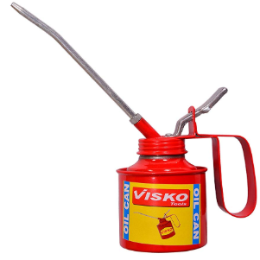
Consumables are Variable Cost and Direct Cost
Consumables

Slide 39




Variable Cost
Packaging and Delivery
Transportation: Variable Cost

Slide 40
Variable Cost Per Unit
Direct material cost: ₹ 530 per unit
Consumables: ₹ 15 per unit
Packaging: ₹ 10 per unit
Transportation, delivery and other miscellaneous: ₹ 20 per unit
Total variable cost per unit: ₹ 575

Slide 41
Variable Cost
Any cost that is proportional to the level of activities is variable cost.
Raw-materials, power, labor cost, consumables etc. are variable cost.

Slide 42
Using Formula: Estimating Break Even Point (BEP)
Profit P = Sales minus all the Costs
Costs: Fixed (F: total per period) and Total Variable (V: per unit)xQ
Assume, Selling Price = S; Quantity Sold = Q; Profit = P
Targeted Profit
Sales = Q*S; Total variable cost = Q*V; Total Cost =Q*V + F
Or

Slide 43
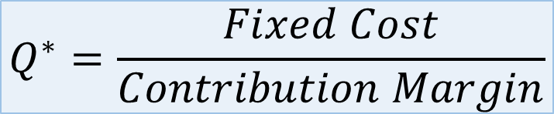
Quantity to be Produced and Sold to Break Even
*
$$Q^{∗}=\frac{Fixed Cost}{Contribution Margin}$$
Selling price(S) – Unit variable cost(V) = Contribution Margin
Total sales – Total variable cost = Contribution (total contribution)

Slide 44
Contribution Margin
Selling price per unit shirt: ₹ 800
Variable cost per unit shirt: ₹ 575
Contribution margin = Selling price – unit variable cost
= ₹ 800 – ₹ 575 = ₹ 225
If you are manufacturing ‘n’ number of shirts, the contribution = ₹ nX225
Remember, you have to recover the fixed cost.

Slide 45
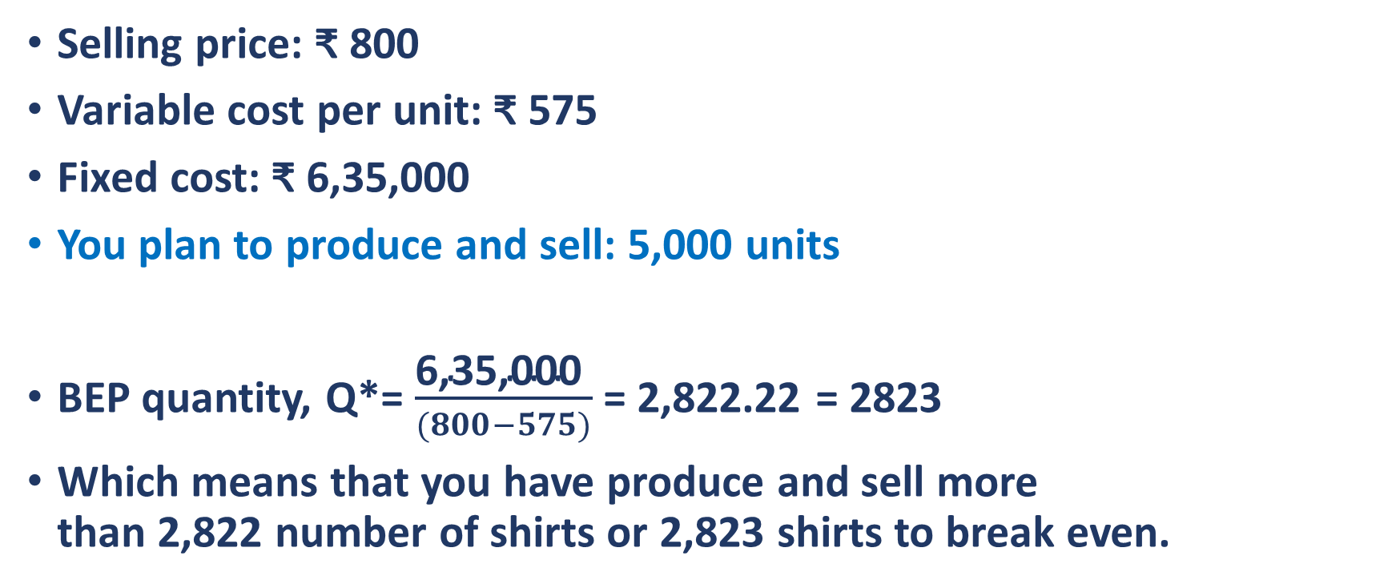
Example
Selling price: ₹ 800
Variable cost per unit: ₹ 575
Fixed cost: ₹ 6,35,000
You plan to produce and sell: 5,000 units
BEP quantity, Q*= $\frac{\text{6,35,000 }}{(800−575)}$ = 2,822.22 = 2823
Which means that you have produce and sell more than 2,822 number of shirts or 2,823 shirts to break even.

Slide 46
Contribution and Contribution Margin
Selling Price of one unit of product (say one number or one kg) = S
Variable cost PER UNIT (including materials, wages, electricity, transportation, fuel, maintenance, advertisement, etc.) = V
Contribution = S – V
Contribution is equal to the price per unit minus the variable cost per unit.
It is also referred to as CONTRIBUTION MARGIN in the context of single unit.
Contribution from unit product
= Selling Price – Unit Variable Cost
Total Contribution = Total Sales – Total Variable Cost

Slide 47
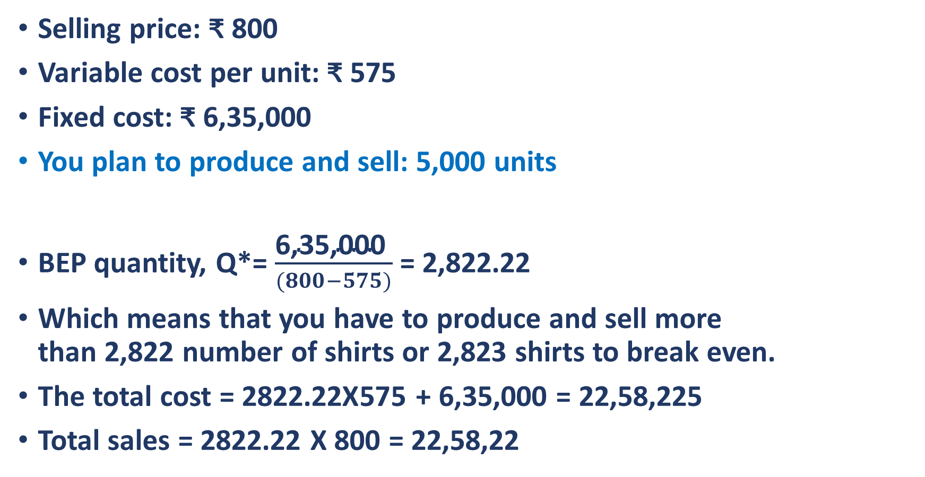
Example
Selling price: ₹ 800
Variable cost per unit: ₹ 575
Fixed cost: ₹ 6,35,000
You plan to produce and sell: 5,000 units
BEP quantity, Q*= $\frac{\text{6,35,000 }}{(800−575)}$ = 2,822.22
Which means that you have to produce and sell more than 2,822 number of shirts or 2,823 shirts to break even.
The total cost = 2822.22X575 + 6,35,000 = 22,58,225
Total sales = 2822.22 X 800 = 22,58,22

Slide 48
Revenue is all you have to recover all the expenses from and the surplus remaining after meeting all expenses is the profit that belongs to you.
Sales
Materials cost
Investment in fixed assets
Investment in R&D
Investment in Brand building
Profit
All Operating Expenses
Depreciation
Amortization
Amortization

Slide 49
Recovery of Cost of Fixed Assets in the Form of Depreciation
Money spent on machinery has to be recovered.
Any recovery of expense is done only through the mechanism of costing of you products or services – you add all the expenses to estimate total cost of a product and then set the price of the product accordingly.
As customers pay you money, your cost is recovered.
Money spent to acquire fixed assets such as machinery is charged in the cost in the form of Depreciation.

Slide 50
Another Simple Example
The following are the fixed and variable costs of a company during a particular year. The unit price of the item is Rs 30. Estimate the BEP production. Note that repair and maintenance cost is a semi-variable cost. So part of it has been considered as fixed cost and part as variable cost.
Find the quantity to be produced to breakeven.
If the production plan is 2,000 units annually, what is the profit/loss?
 | Fixed Cost (Rs/year) | Variable Cost (Rs/unit)
Depreciation Insurance Repair & Maintenance Material Labour and Power | 20,000 5,000 5,000 | 0.50 9.50 10.00
Total | 30,000 | 20.00

Slide 51
Solution:
Given
F = ₹ 30,000 per year, V = ₹ 20 per unit, S = ₹ 30 per unit
The breakeven production quantity is given by
The production plan during the year is Qp = 2,000 units/year.
Total revenue during the year = (2,000)(30) = ₹ 60,000
Total cost during the year = 30,000 + (2,000)(20) = ₹ 70,000. Cost is more than sales.
Therefore, loss for the year = ₹ 10,000
How many units need to be produced to make profit of ₹ 10,000/-?
units/year

Slide 52
Solution of Second Part
To make profit of ₹10,000, your sales should exceed aggregate of fixed cost and the variable cost by ₹10,000.
Therefore: Q* X V + F + 10,000 = Q* X S
Or, 20 X Q + 30,000 + 10,000 = Q* X 30
Or, 10 X Q = 40,000
Or, Q = 4,000, You have to produce and sell 4,000 units to make a profit of ₹ 10,000.
Alternately: contribution margin is ₹10. BEP is 3,000 units. You have to produce 10,000/10 = 1,000 extra units after BEP, which is
= 4,000 units.

Slide 53
Graphical Representation of Break Even Point (BEP)
Total Sales = P*Q
Profit zone
Total Cost = V*Q + F
Cost, Sales
Variable Cost
Fixed Cost
Loss zone
Breakeven Point
2823
Quantity
5,000

Slide 54
Margin of Safety
Margin of safety is the number/amount by which the planned sales is above the break-even point.
It indicates the number/amount by which the sales of a company may decrease without causing loss.
Putting it differently, it signifies how sensitive is your present operation to the market fluctuation.

Slide 55
Breakeven Point and Margin of Safety
It is the number of units to produce and sell at which the total cost is just equal to total sales.
The break even point is the level of production and sales where total revenue equals total expenses.
In other words, the break-even point is where sales of a company is exactly equal to total expenses or costs.
Costs are divided into two categories: Fixed cost and Variable cost
Variable costs vary with the level of production and sales such as material cost, wages, consumable, transportation, etc.

Slide 56
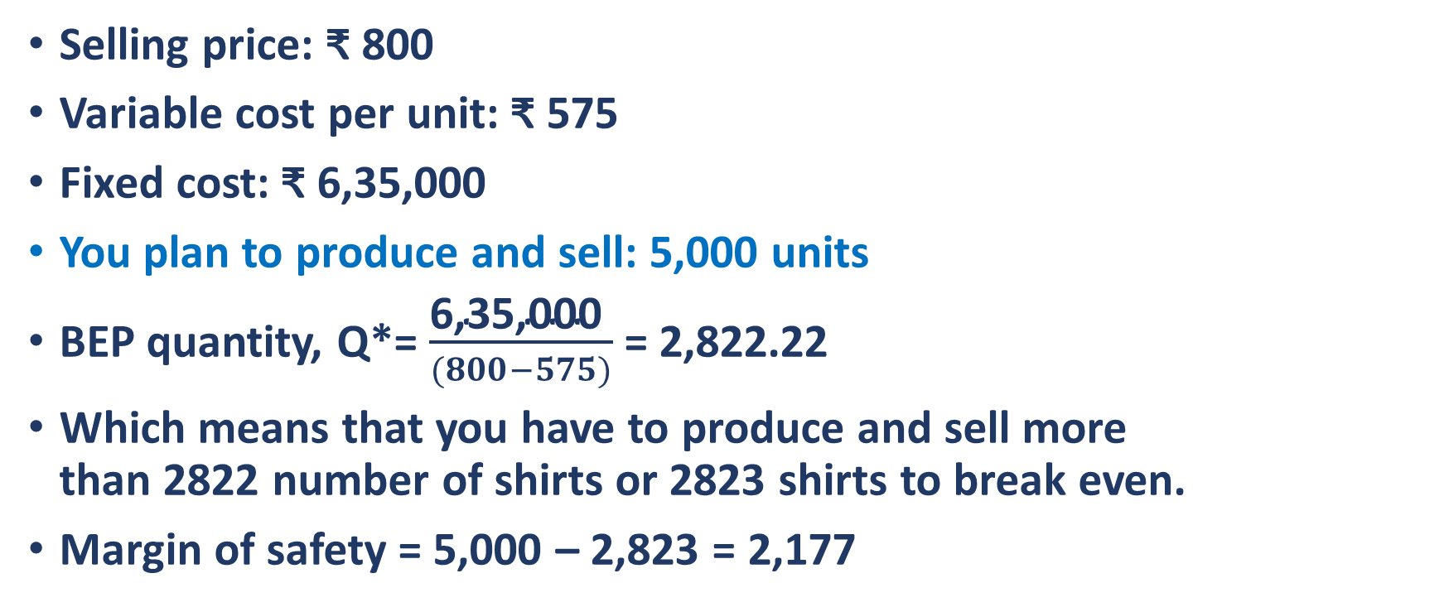
Margin of Safety
Selling price: ₹ 800
Variable cost per unit: ₹ 575
Fixed cost: ₹ 6,35,000
You plan to produce and sell: 5,000 units
BEP quantity, Q*= $\frac{\text{6,35,000 }}{(800−575)}$ = 2,822.22
Which means that you have to produce and sell more than 2822 number of shirts or 2823 shirts to break even.
Margin of safety = 5,000 – 2,823 = 2,177

Slide 57
Graphical Representation
Total Sales = P*Q
Profit zone
Total Cost = V*Q + F
Variable Cost
Cost, Sales
Fixed Cost
Loss zone
Planned production and sales
Margin of Safety 2,177 units
Breakeven Point
2,823
Quantity
5,000

Slide 58
Some Assumptions and Limitaions
1
2
3
4
5
6
7
8
Cost can be divided into fixed and variable (semi-variable subdivided)
Linear relation assumed.
Selling price, variable cost per unit, and total fixed cost remain constant.
Volume is the only cost driver for variable cost.
Relevant range of volume is specified within which assumptions hold.
Inventory level is assumed to remain constant.
Sales mix is not changed for the estimation.
You sell all that you produce. No inventory build up.

Slide 59
Some More Assumptions
1
2
3
Change in volume of sales does not affect the price of the product.
Labour cost (wages) per unit of product remains constant.
Either estimate the BEP for one product or the sales mix does not change during the estimation horizon.

Slide 60
Limitations
Break-even helps only to analyze different scenarios. It does not tell us if particular context is achievable. For example, it presupposes that any desired quantities can be sold.
The ‘no inventory buildup’ assumption is hard to achieve in reality.
Under the ‘multiproduct scenario’, it assumes that the relative proportions of each product remain constant. It is likely to change in reality.

Slide 61
Suppose You Reduce the Variable Cost
Margin of Safety
Total Sales = P*Q
Profit zone
Total Cost = V*Q + F
Breakeven Point
Variable Cost
Cost, Sales
Fixed Cost
Planned production and sales
Loss zone
Quantity
1,823
2,823
5,000

Slide 62
Graphical Representation: Reduce the Variable Cost
Total Sales = P*Q
Previous Total Cost = V*Q + F
Breakeven Point
New Total Cost = V*Q + F
Profit zone
Previous Variable Cost
Previous Variable Cost
Cost, Sales
Fixed Cost
New Variable Cost
Loss zone
Margin of Safety
Planned production and sales
Quantity
1,500
2,823
5,000

Slide 63
Suppose You Reduce the Variable Cost
Total Sales = P*Q
Total Cost = V*Q + F
New Variable Cost
Cost, Sales
Fixed Cost
Quantity
1,500
2,823
5,000

Slide 64
Suppose You Reduce the Variable Cost
Total Sales = P*Q
New total Cost = V*Q + F
Total Cost = V*Q + F
New Variable Cost
Cost, Sales
New fixed Cost
Fixed Cost
Quantity
1,500
2,823
5,000

Slide 65
Graphical Representation: Fixed Cost Goes up Variable cost goes down
Total Sales = P*Q
Margin of Safety
Profit zone
Total Cost = V*Q + F
Breakeven Point
Variable Cost
Cost, Sales
Fixed Cost
Loss zone
Planned production and sales
2,500
Quantity
2,823
5,000

Slide 66
Suppose You Reduce the Variable Cost and increase the fixed cost
Total Sales = P*Q
Total Cost = V*Q + F
Variable Cost
Cost, Sales
Fixed Cost
Quantity
2,700
2,823
5,000

Slide 67
 | Units | ₹ |  | BEP
Sales | 500 | 40,000
Total variable cost | 500 | 15,000 |  |  | You have to classify fixed and variable costs
Total annual fixed cost |  | 20,000 |  | 400
What is the contribution margin?
What is the contribution?
Estimate BEP
If the company produces 250 or 600 units, what is the margin of safety?
If the company produces 250 or 600 units, how much is the profit?

Slide 68
Operating Leverage
Operating leverage is the degree to which a firm can increase operating income by increasing sales.
Lower the variable cost, higher the operating leverage.
Operating leverage refers to the percentage of fixed costs that a company has compared to variable cost. Stated another way, operating leverage is the ratio of fixed costs to variable costs.
Financial leverage refers to the amount of debt in the capital structure of the company. If you can visualize a balance sheet, financial leverage refers to the ‘Equity & Liabilities’ side of the balance sheet.

Slide 69
High operating leverage means that the fixed cost of a company is high compared to the variable cost. In this case, the firm, after break-even, earns a large profit on each incremental sale.
But the break-even point of the company is at a high level indicating that the company must attain sufficient sales volume to cover its high fixed costs.
Low operating leverage means the major part of the cost is variable in nature. In this case, the firm achieve break-even with small sales, but earns a small profit on each incremental sale post breakeven.
After meeting the fixed cost, unit contribution or contribution margin is more if the variable cost is less
Contribution = Selling price – unit variable cost
Think in terms of marginal cost & revenue/contribution/profit

Slide 70
TC 1
FC 1
FC 2
VC 1

Slide 71
TC 1
FC 1
TC 2
FC 2
VC 2
VC 1

Slide 72
Total Cost 1
Total Cost 2
Fixed Cost 2
Fixed Cost 1

Slide 73
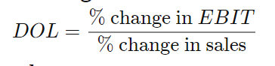
Total Cost 1
Total Cost 2
Fixed Cost 2
Fixed Cost 1

Slide 74
Compare the following two alternatives
High DOL
Low DOL
Annual production & sales: 1,000 units
Variable cost per unit: 15
Annual fixed cost: 20,000
Selling price: 40 per unit
At the present production, unit fixed cost = 20,000/1,000 = 20
Profit/loss = Sales – total cost = 40,000 – (20,000 + 15,000) = ₹5,000
Marginal revenue: 40
Marginal cost: 15
Profit for 1 extra unit: 25
Annual production & sales: 1,000 units
Variable cost per unit: 20
Annual fixed cost: 20,000
Selling price: 40 per unit
At the present production, unit fixed cost = 2,00,000/1,000 = 20
Profit/loss = Sales – total cost = 40,000 – (20,000 + 20,000) = ₹0.
Marginal revenue: 40
Marginal cost: 20
Profit for 1 extra unit: 20

Slide 75
Compare the following two alternatives
High DOL
Low DOL
Annual production & sales: 1,000 units
Variable cost per unit: 15,000
Annual fixed cost: 20,00,000
Selling price: 25,000 per unit
At the present production, unit fixed cost = 20,00,000/1,000 = 2,000
Profit/loss = Sales – total cost = 2.5 – 1.7 cr. = 0.8 cr.
Marginal revenue: 25,000
Marginal cost: 15,000
Profit for 1 extra unit: 10,000
Annual production & sales: 1,000 units
Variable cost per unit: 20,000
Annual fixed cost: 2,00,000
Selling price: 25,000 per unit
At the present production, unit fixed cost = 2,00,000/1,000 = 200
Profit/loss = Sales – total cost = 2.5 – 1.7 cr. = 0.8 cr.
Marginal revenue: 25,000
Marginal cost: 20,000
Profit for 1 extra unit: 5,000

Slide 76
Cost Indifference Point
The cost indifference point is the level of production (and sales) at which the profit is indifferent of the two strategies with different cost structures.
Used to compare two strategies, this analysis can be used to decide between different cost structures or selling prices.

Slide 77
Graphical Estimation of Cost Indifference Point
If your targeted sales is above cost indifference point, say at 12,000 units, strategy 1 is better.
If your targeted sales is below cost indifference point, say at 12,000 units, strategy 2 is better.

Slide 78
Cost Indifference Point
The cost indifference point is used to compare two different strategies for executing the same business.
For example: You want to start a 10 carat gold jewelry business. Strategy 1: putting up a fully automatic plant that would cost huge capital investment, say ₹ 1.0 crore, but recurring expenses are low, say ₹ 4,000 per piece. Strategy 2: Setting up a labour-intensive unit with no automation. The capital investment is only ₹ 10 lakh. The capital cost is low but recurring expenses are high @ say ₹4,600 per piece and selling price is higher by (say) 100.
First question is which business is more attractive?
Where is the cost difference point?

Slide 79
Cost indifference point: A company has two alternatives to implement a business: i. using automation, ii. Using labor intensive technology.
First alternative,
Variable cost per unit: 40
Total fixed cost per year: 50,000
Selling price per unit: 100
Contribution = 100 – 40 = 60
Second alternative
Variable cost per unit: 60
Total fixed cost per year: 30,000
Selling price per unit: 100
Contribution = 100 – 60 = 40
At cost indifference point, profit is equal in both alternatives.
60[contribution]*Q – 50,000[fixed cost] = 40[contribution]*Q – 30,000[fixed cost]
60*1,000 – 50,000 = 40*1,000 – 30,000
At Q = 1,000, profit is same in both alternatives.

Slide 80
Classification of some regular cost items
Depreciation | Fixed
Insurance | Semi-Variable
Interest on Long-Term Loan | Fixed
Audit Fee, Trade license, Fire safety | Fixed
RoC Registration Fee | Fixed
Rent | Fixed
Salaries | Fixed
Raw-materials, consumable, Wages | Variable
Electricity Bill Payment | Variable
Fuel Cost | Variable
Transportation cost | Variable
Stationery | Variable
Annual renewal of export license | Fixed
Printing | Variable
Internet and data plan | Fixed
Income tax | Not cost
Web-hosting cost | Fixed
Cost of security | Fixed
Production bonus | Variable
Traveling expenses | Variable
Dividend | Not a cost
Telephone bill payment | Variable
Sales promotion | Variable
Insurance of factory premises | Fixed
Insurance of vehicle | Fixed
Insurance of Inventory | Variable
Insurance and maintenance are semi-variable costs.
Item |  |  | Type | Comment
Depreciation | 1500 |  | Fixed
Insurance | 100 |  | Variable | Consider as variable for now. (in reality it may have two components)
Interest on long-term loan | 250 |  | Fixed
Interest on short-term loan | 450 |  | Variable
Audit fee | 50 |  | Fixed
RoC registration fee | 20 |  | Fixed
Rent | 120 |  | Fixed
Salaries | 3000 |  | Fixed
Wages | 2100 |  | Variable
Advertisement | 100 |  | Variable
Maintenance | 50 |  | Variable
Electricity cost | 40 |  | Variable
Fuel cost | 35 |  | Variable
Transportation | 150 |  | Variable
Stationery | 10 |  | Variable
Dividend |  |  |  | Not a cost
Printing cost | 20 |  | Variable
Internet and data plan cost | 12 |  | Fixed
Income tax |  |  |  | Not a cost
Web-hosting cost | 22 |  | Fixed
Cost of maintaining security around the factory | 25 |  | Fixed
Rent | 120 |  | Fixed
Production bonus (related to higher production) | 120 |  | Variable
Traveling expense | 25 |  | Variable
Telephone bill payment | 10 |  | Variable
Sales promotion cost | 50 |  | Variable
Annual renewal of export license | 30 |  | Fixed
Insurance for vehicle | 40 |  | Fixed | Ignore for now
Insurance for inventory and other assets of the factory | 30 |  | Variable | Ignore for now
Sales | 5000
Number of unit sold | 500

Slide 81
Uses of BEP
Provides information on minimum sales for achieving profit.
Helps to compare multiple business opportunities and multiple options for executing a business.
Estimate amount of goods to be sold in order to meet all expenses.
Level of production and profit thereof.
Act as a milestone for the entire team to achieve targeted sales.
Gives idea about margin of safety and risk thereof.
Understand the price sensitivity of profit and decide on price.
Cost control, decide on cost structure, and quick estimate.

Slide 82
Limitations of BEP
Many assumptions based on which BEP is estimated are unrealistic.
For example:
Fixed cost may vary with turnover, over time
Variable cost may go down as sales increases due to economy of scale,
It is unlikely that you sell all you produce. Inventory either gets built up or reduces during course of business.
Break-even estimation is easy for simple business such as one product company. It becomes difficult for multiple products.

Slide 83
Final Thought
Advantages outweigh limitations. Using it judiciously is very helpful in planning as also decision making.
It is specially helpful for startups in selecting opportunities or projects out of many options and understanding level of operation to be profitable.

Slide 84
Inventory Costs You Money. Try Keeping it Low.
Suppose you maintain inventory of fabric, button, consumable and finished goods stock of ₹ 13 million (on an average) over the year.
Suppose you have borrowed ₹ 10 million from bank to maintain this stock (inventory) as working capital loan.
Let us assume that the rate of interest on bank loan is 15% p.a.
You have to pay interest on ₹ 10 million on average loan of ₹1.5 million. Say, you incur loss of 0.5 million in a year.
If you can smartly manage your inventory, perhaps you can smoothly manage the business with ₹7 million and reduce bank loan to ₹5 million.
Therefore, your interest will come down to ₹ 0.75 million only.
Just by managing the inventory efficiently, you have transformed loss into profit.
In case you do not borrow working capital, still you incur opportunity cost.
Notes:
It is important to understand that if you see anything in your shop – floor and you can do business without it, you can increase your profit by doing without it. Because everything costs you money.

Slide 85
The operating leverage (OL) would look like the following if one plots the OL over quantity
Operating leverage
Number of unit sold
Break even (quantity) point
You may neglect this slide for examination purpose. It is included only for those who may have questions.

Slide 86
For each unit of extra sales beyond BEP, Option 2 generates higher profit compared to Option 1.
For each unit of lower sales from BEP, Option 2 inflict higher loss compared to Option 1.

Slide 87
Key Takeaways
The degree of operating leverage (DOL) measures the change in operating income of a company in response to change in sales.
The DOL helps analysts gauging the impact of change in sales on earnings.
If sales increases in large measure for a company of high operating leverage, the profit will increase substantially.
On the other hand, if sales declines beyond BEP, the loss will increase faster compared to a company with lower DOL. That is why DOL is a component of risk perception.
DOL is exciting for companies operating beyond BEP and is too bad for companies operating below BEP.

Slide 88
The 10 carat gold jewelry cost indifference point
Fixed cost per year: 1,00,00,000
Variable cost per unit: 4,000
Selling price per unit: 5,000
Contribution (per unit): 5,000 – 4,000 = 1,000
Fixed cost per year: 10,00,000
Variable cost per unit: 4,600
Selling price per unit: 5,100
Contribution: 5,100 – 4,600 = 500
At cost indifference point: profit in option 1 is equal to profit in option 2, say at quantity Q
Therefore, (5,000 -4,000)*Q – 1,00,00,000 = (5,100 – 4,600) – 10,00,000
Q = 18,000
If you foresee sales much above 18,000 units, should go for automation model
If sales are to be much less than 18,000 units, adopt the labor-intensive model.
Both models are similar if sales is close to 18,000 units

Slide 89
Conclusion:
BEP estimation is based on many assumptions that may not always hold.
All data are futuristic and are subject to market change.
However, most assumptions and future fluctuations would be neutralized when multiple businesses are compared.

Slide 90
Thank you

Slide 91
The financial leverage ratio indicates the overall debt load of a company compared to its assets or equity.
Putting it differently, it shows what portion of its assets has been financed by (and owned by) the shareholders (owners of the company) and how much by the creditors (lenders).
Shareholders owning a majority of the assets: low leverage
Creditors owning a majority of the assets: highly leveraged.
In all, financial leverage is an indicator of risk of the capital structure.

Slide 92
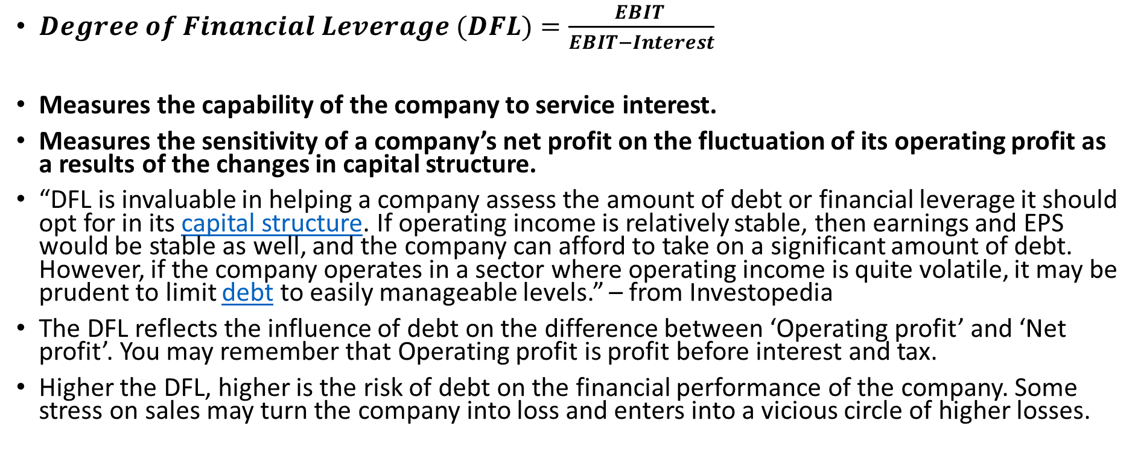
Degree of Financial Leverage
$Degree of Financial Leverage (DFL)=\frac{EBIT }{EBIT−Interest}$
Measures the capability of the company to service interest.
Measures the sensitivity of a company’s net profit on the fluctuation of its operating profit as a results of the changes in capital structure.
“DFL is invaluable in helping a company assess the amount of debt or financial leverage it should opt for in its capital structure. If operating income is relatively stable, then earnings and EPS would be stable as well, and the company can afford to take on a significant amount of debt. However, if the company operates in a sector where operating income is quite volatile, it may be prudent to limit debt to easily manageable levels.” – from Investopedia
The DFL reflects the influence of debt on the difference between ‘Operating profit’ and ‘Net profit’. You may remember that Operating profit is profit before interest and tax.
Higher the DFL, higher is the risk of debt on the financial performance of the company. Some stress on sales may turn the company into loss and enters into a vicious circle of higher losses.

Slide 93
People are generally infatuated about their own ideas. They mostly focus on the inventive steps, intellectual depth and novelty.
They are frequently blind about the unique requirements of customers and cost of their products or services.
They end up investing valuable time and resources only to eventually realize that the product or service they so assiduously made is not attractive to customers.
A clear understanding of the value proposition, on the other hand, helps to choose the right idea early on saving the time and avoiding cash burn on potentially failing ideas.

Slide 94
Getting more out of less
You get granular actionable insight
Problem
The solution
The value
Lead to the story
Articulate value

Slide 95
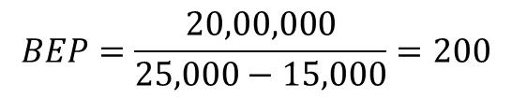
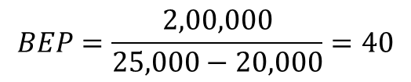
Comparison between companies of high and low DOL
High DOL company
Low DOL company
One extra unit of sales will generate profit of 10,000
One less unit of sales will generate loss of 10,000
One extra unit of sales will generate profit of 5,000
One less unit of sales will generate loss of 5,000
$$BEP=\frac{20,00,000}{25,000−15,000}=200$$
$$BEP=\frac{2,00,000}{25,000−20,000}=40$$
On absolute basis
At the present position, DOL for the ‘High DOL’ company, the DOL% is = 1000*10000/(1000*10000-2000000) = 1.25, which means that for 1% increase in sales the operating profit increases by 1.25% and vice versa.
The DOL for the ‘Low DOL’ company, the DOL% is = 1000*5000/(1000*5000-200000) = 1.04, which means that for 1% increase in sales the operating profit increases by 1.04% and vice versa.
On percentage basis, the DOL changes as volume of sales changes.
On percentage basis

Slide 96
At the present position, DOL for the ‘High DOL’ company, the DOL% is = 1000*10000/(1000*10000-2000000) = 1.25, which means that for 1% increase in sales the operating profit increases by 1.25% and vice versa.
The DOL changes to 1.02 at sales of 10,000 unit.
The DOL for the ‘Low DOL’ company, the DOL% is = 1000*5000/(1000*5000-200000) = 1.04, which means that for 1% increase in sales the operating profit increases by 1.04% and vice versa.
The DOL changes to 1.001 at sales of 10,000 unit.
On percentage basis, the DOL changes as volume of sales changes.

